Slide 1
An Experiment on Point Cloud Completion
工学院 钱浩
1901213616

Slide 2
Introduction
Why 3D Point Cloud Completion？
occlusion,
light reflection,
transparency of surface material
limitations of sensor resolution and viewing angle
a loss of geometric and semantic information
Paper Reading Presentation

Slide 3
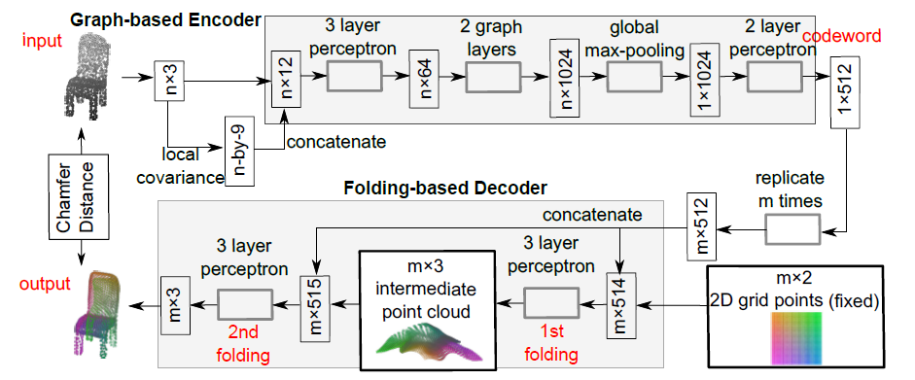
Motivation
FoldingNet: Point Cloud Auto-encoder via Deep Grid Deformation，CVPR 2018

Slide 4
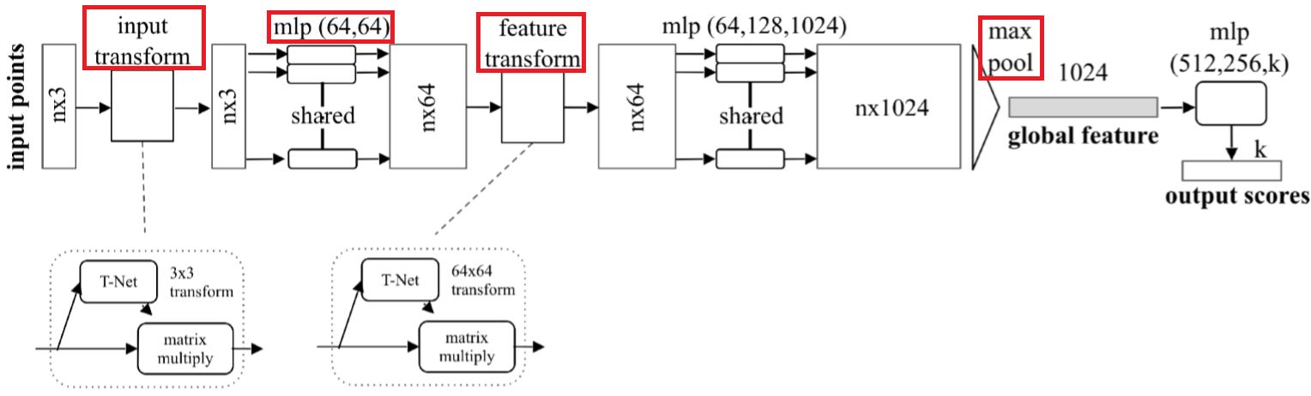
Motivation
PointNet

Slide 5
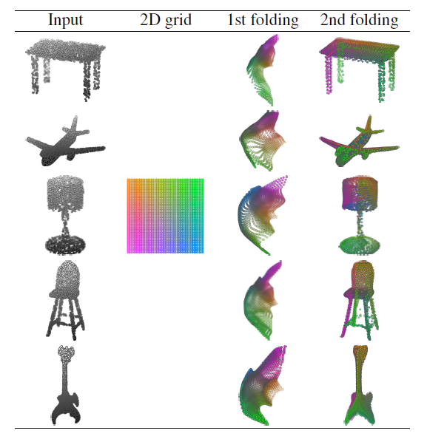
Motivation
Folding Net Results

Slide 6
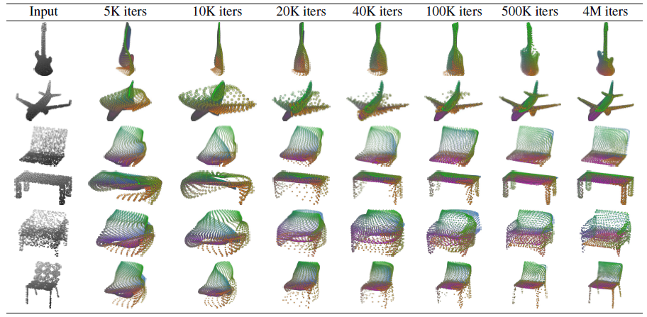
Motivation
Folding Net Results

Slide 7
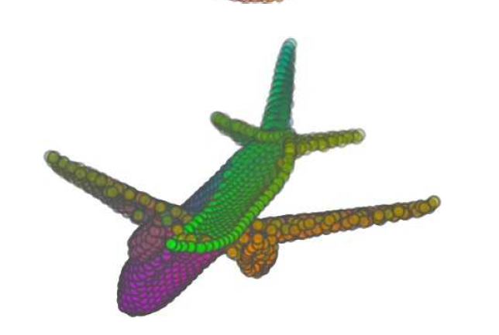
Motivation
Folding Net Results

Slide 8
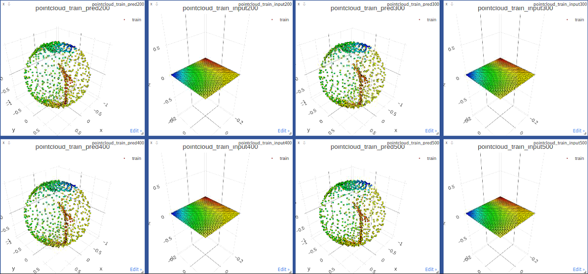
Method
2D grid → 3D boll with Folding Net

Slide 9
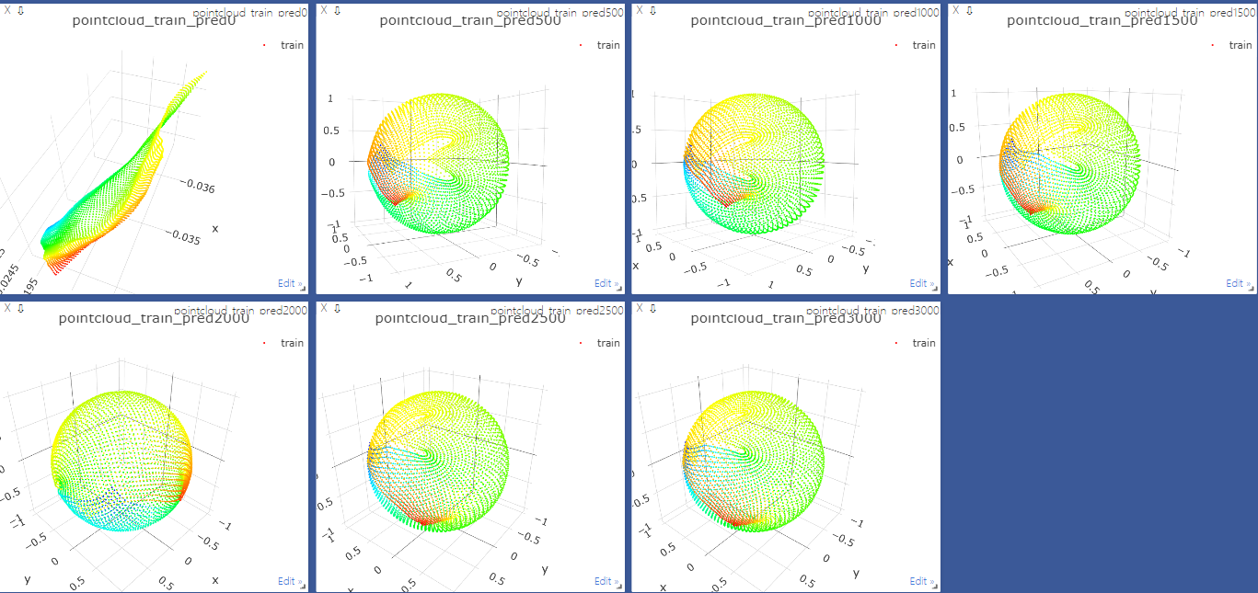
Method
2D grid → 3D boll with MLP

Slide 10
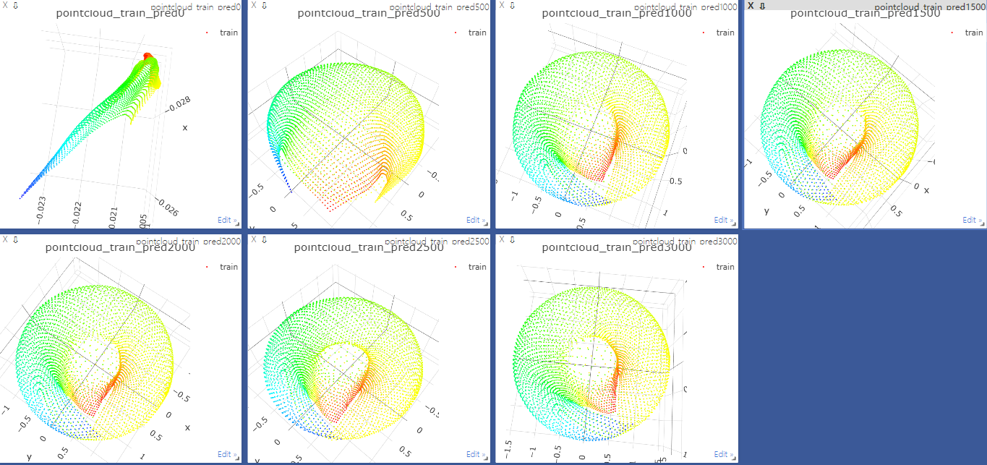
Method
2D grid → 3D donut with MLP

Slide 11
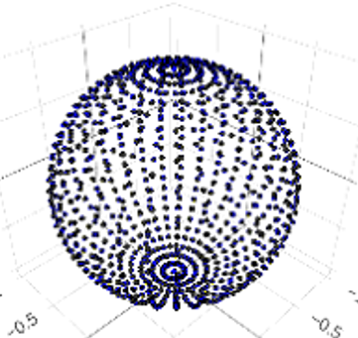
Evaluation

Slide 12
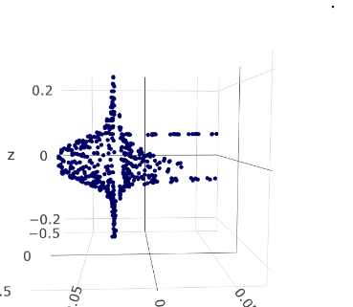
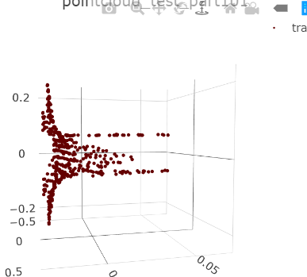
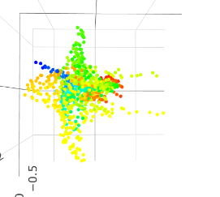
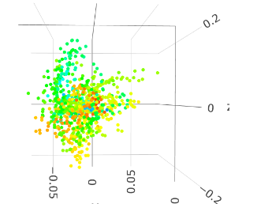
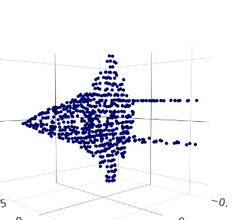
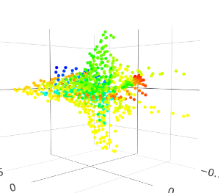
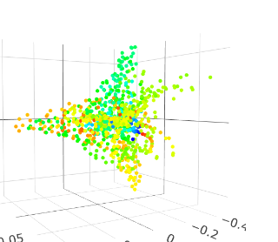
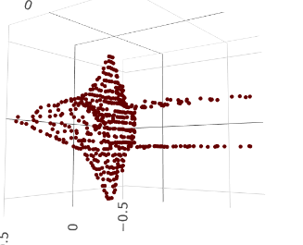
Evaluation
Dataset: Shapenet
GT
part
2D grid
3D ball

Slide 13
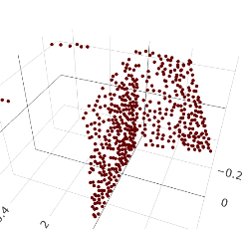
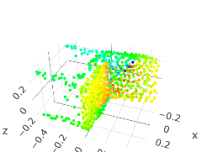
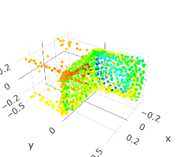
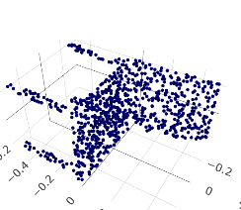
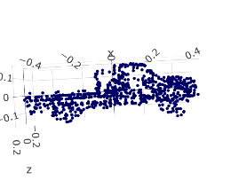
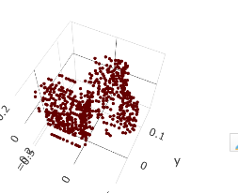
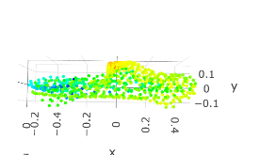
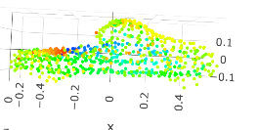
Evaluation
Dataset: Shapenet
GT
part
2D grid
3D ball

Slide 14
Q & A
钱浩
1901213616

